Slide 1

TT06 Professionalize your PowerShell Tools using PlatyPS
Sean Wheeler & Jason Helmick
Microsoft
Level: Intermediate

Slide 2
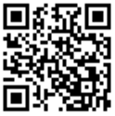
Your feedback is very important to us
Use the QR code or search for “Converge360 Events” in your app store
Find this session on the Agenda tab in the App
Click “Session Evaluation”
Thank you!

Slide 3
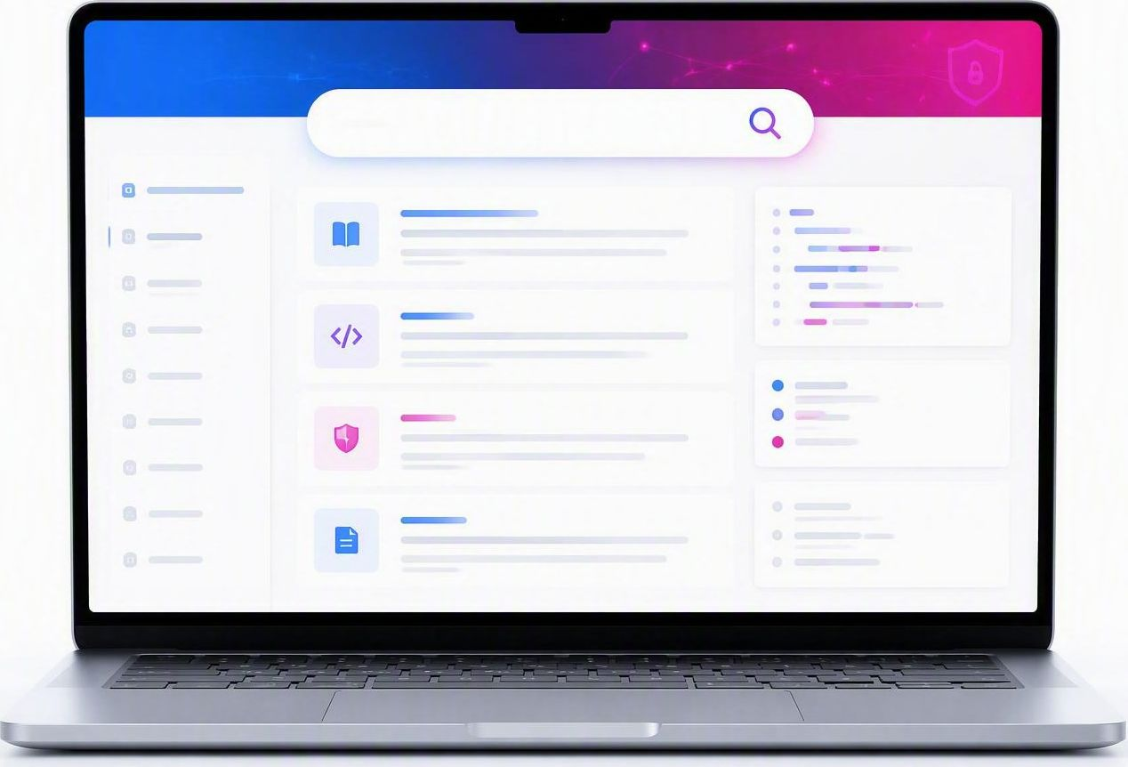
Professional tools have documentation
Do you really have a product without docs?
It’s not a tool if only you can use it.
Docs build trust, enhances discoverability, speeds adoption.
If users can’t discover, understand, and trust it, they won’t adopt it.
The user your docs help may be YOU in 6 months!

Slide 4

Professional Documentation Strategies
Uniform Formatting
Create documentation using standardized templates and formats that meet user expectations, ensuring consistency and clarity.
Automation & Version Control
Integrate docs within the product automation pipeline and use source control systems for managing versions efficiently.
Feedback & Continuous Improvement
Implement feedback mechanisms for continuous improvement and maintain separate pipelines for docs and code to enable rapid docs updates.

Slide 5
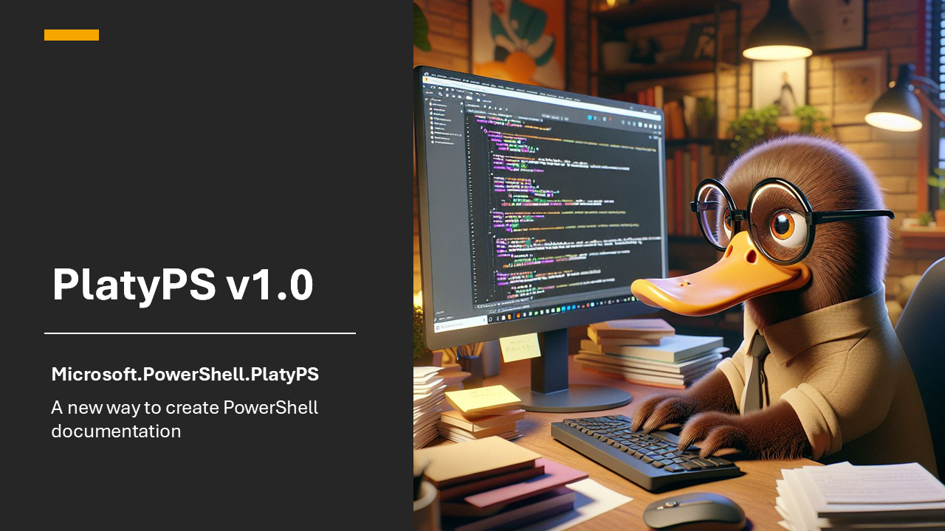

Slide 6
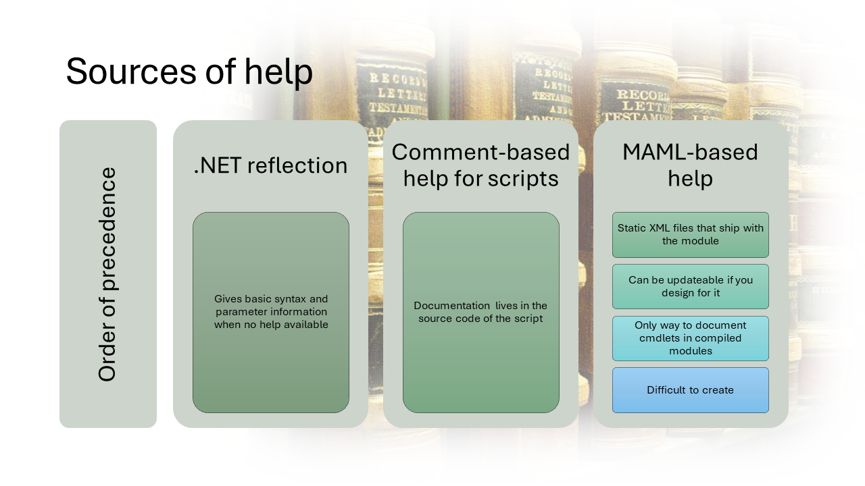

Slide 7
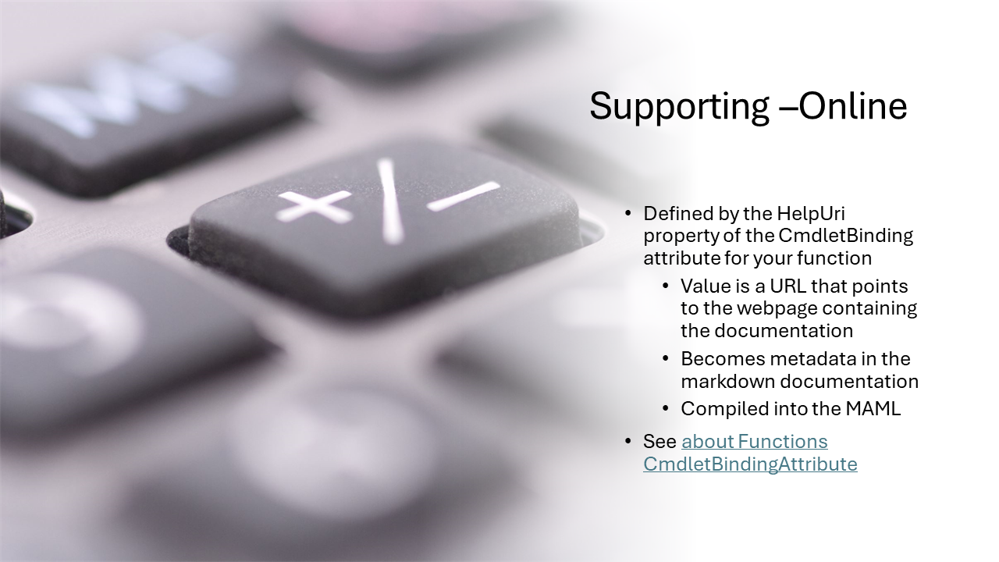

Slide 8
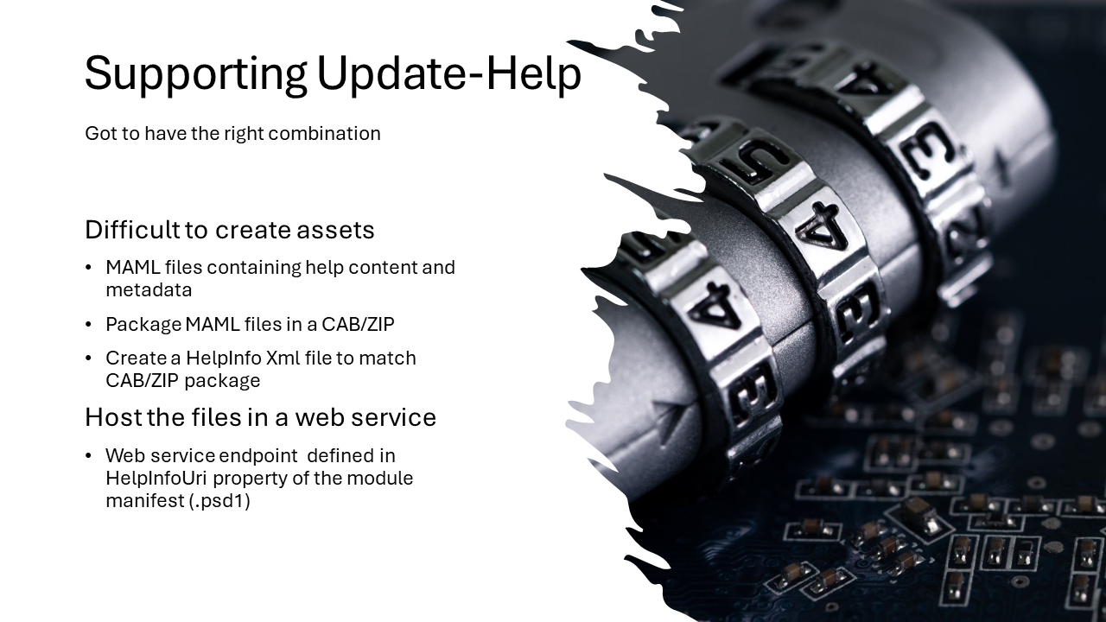

Slide 9
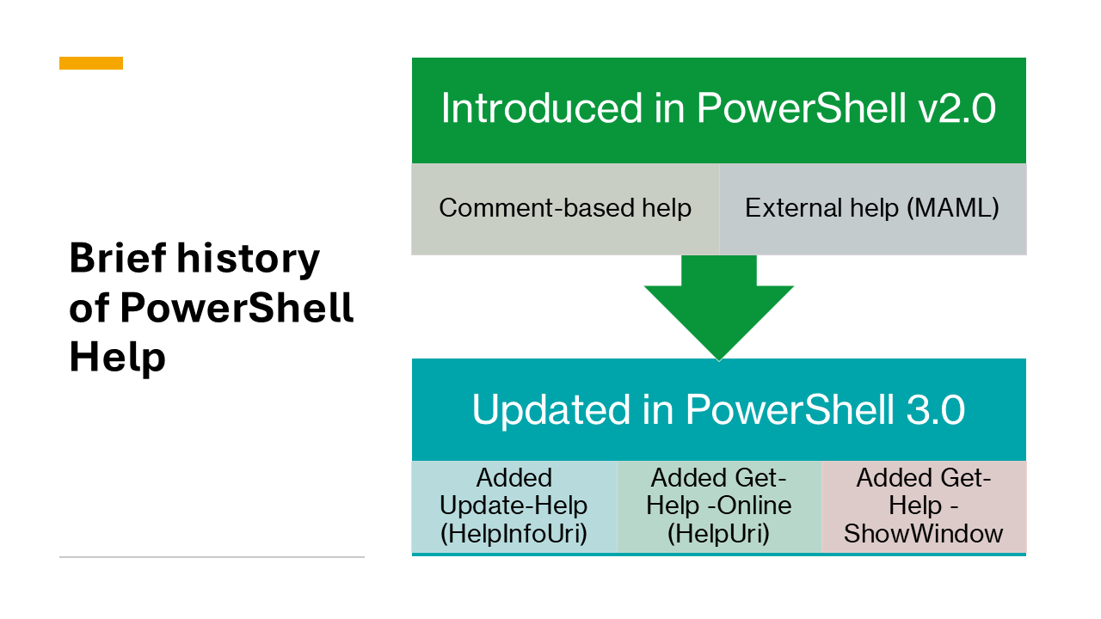

Slide 10
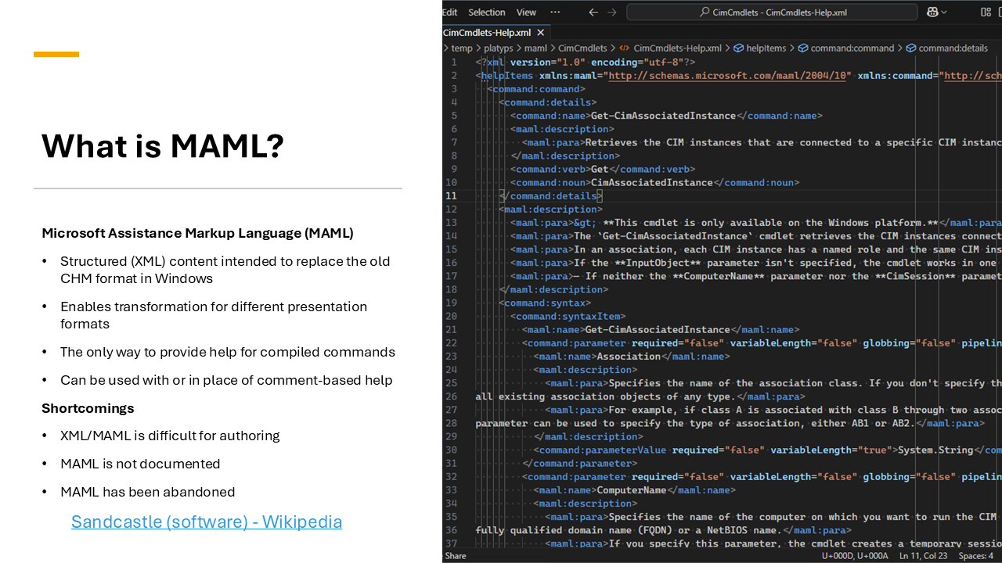

Slide 11
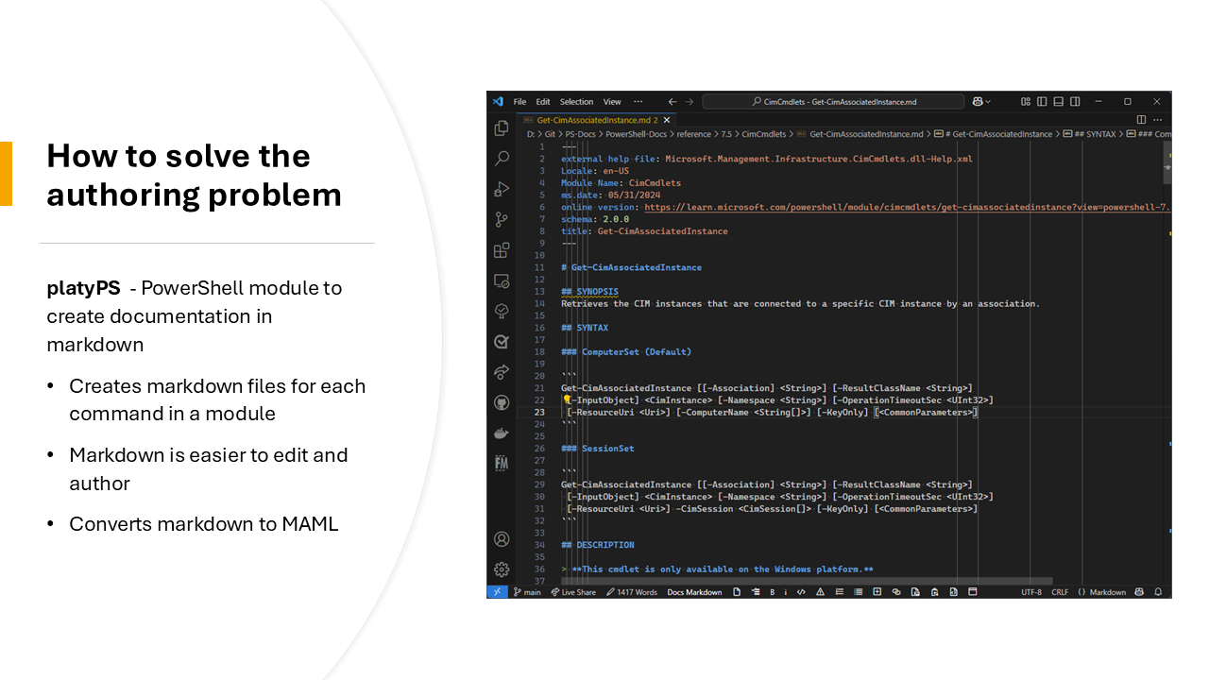

Slide 12
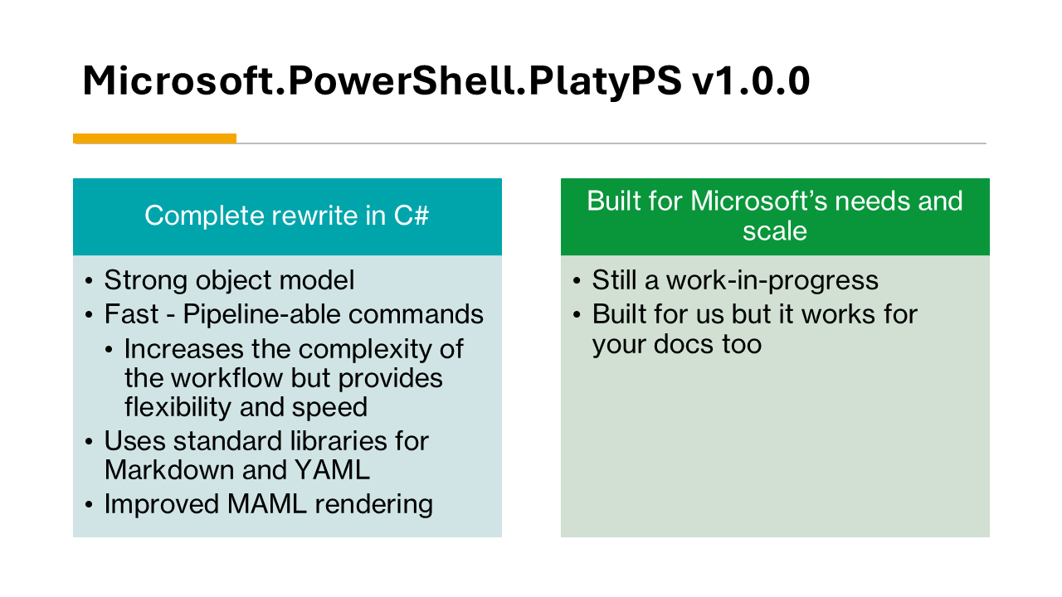

Slide 13
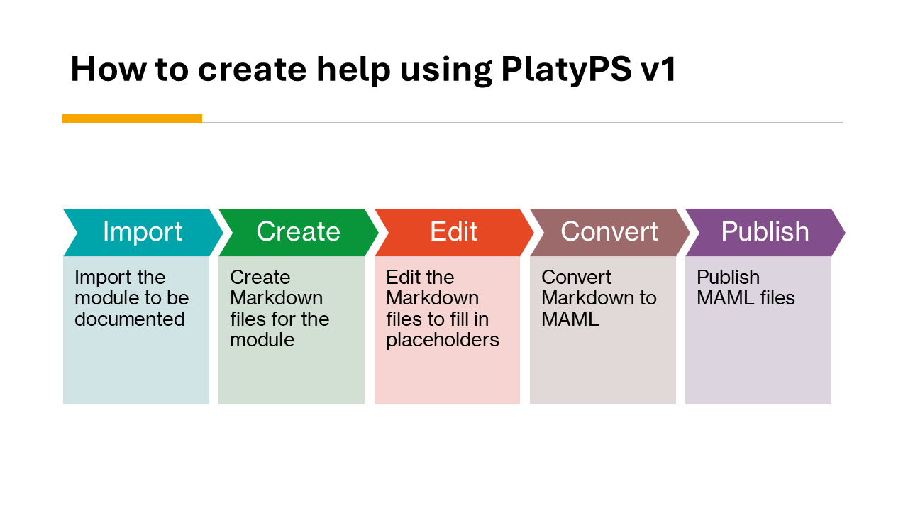

Slide 14
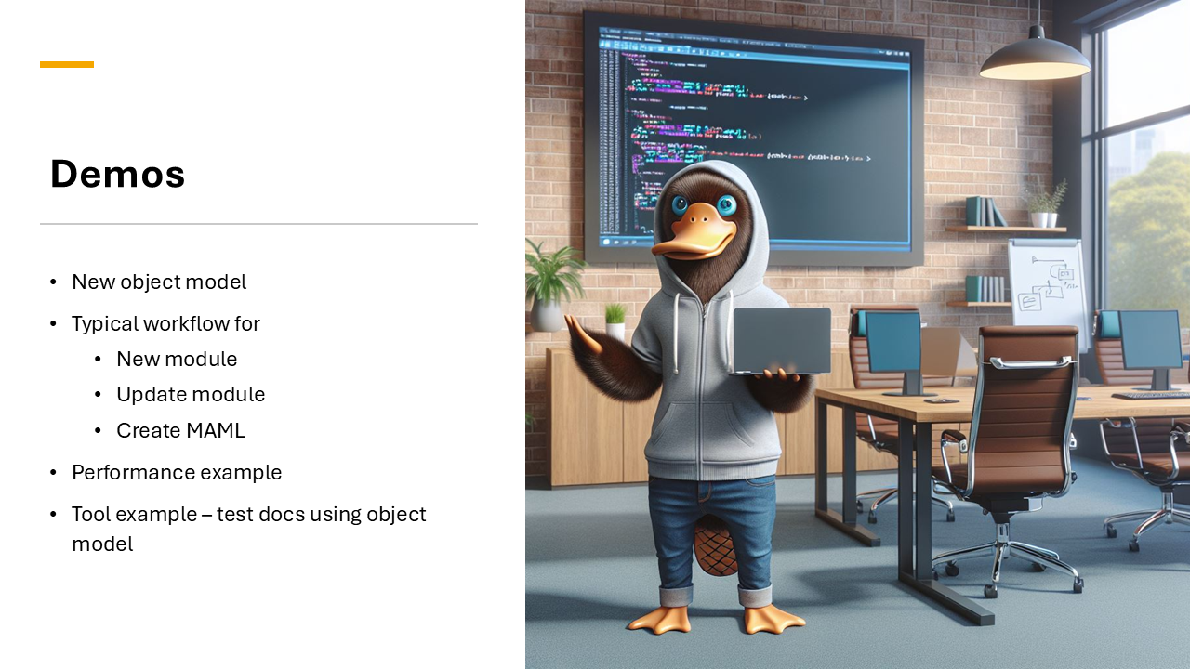

Slide 15
Resources
Presentations
Unlocking the secrets of PowerShell Help
PlatyPS v1.0
Microsoft.PowerShell.PlatyPS v1.0.0
Microsoft.PowerShell.PlatyPS cmdlet reference
Source code
Microsoft.PowerShell.PlatyPS on the PowerShell Gallery
Demo Scripts and samples
Demo data - demo.ps1
Test-ParameterInfo.ps1

Slide 16
Your feedback is very important to us
Use the QR code or search for “Converge360 Events” in your app store
Find this session on the Agenda tab in the App
Click “Session Evaluation”
Thank you!

